Slide 1
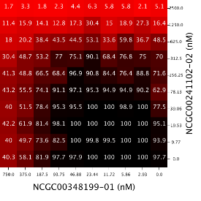
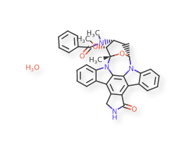
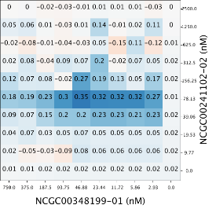
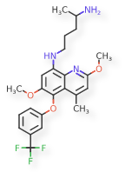
Similar Compounds Show Similar Activities- Does This Hold for Compound Combinations?
Intern: Sarita Lee
Mentors: Raj Guha & Lu Chen

Slide 2
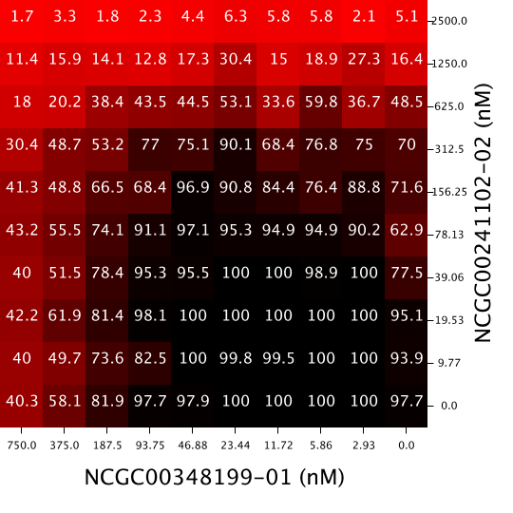
Introduction- Drug Combinations and Synergy
Response Matrix
Drug combinations are used to treat many medical conditions such as: HIV, malaria, and cancer
Sometimes the combined effect of drugs is different than their individual effects
When it is better: synergism
When it is the same: additive
When it is worse: antagonism
Drug Y
Drug X

Slide 3
Introduction- Screening Drug Combinations
Traditionally, screening for drug combinations has been a slow process
Since NCATS has high throughput screening (HTS), we can quickly generate data for thousands of drug combinations
[look at Raj’s slides for images]
Given a response matrix, how do we quantify synergy?
Response Matrix

Slide 4
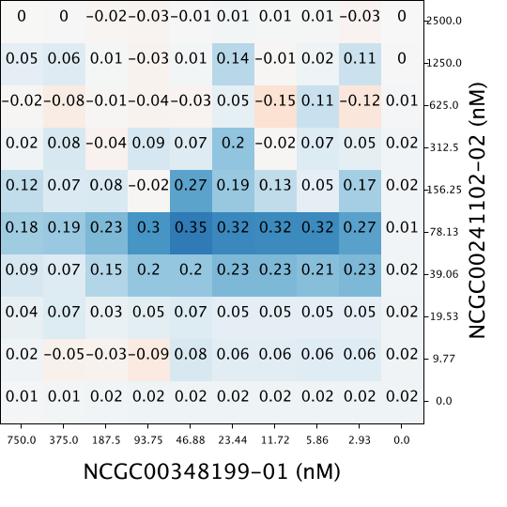
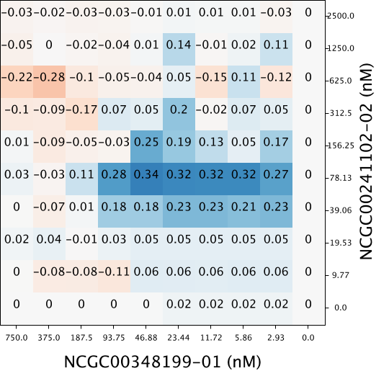
Introduction- Methods to Measure Synergy
Synergy is quantified with respect to a model of additivity
Three Models:
Highest Single Agent (HSA)
Bliss Independence Model
Loewe Additivity Model
Used Bliss Independence Model: convenient and more robust in high throughput setting
Response Matrix
Synergy Matrix-
HSA
Synergy Matrix-
Delta Bliss

Slide 5
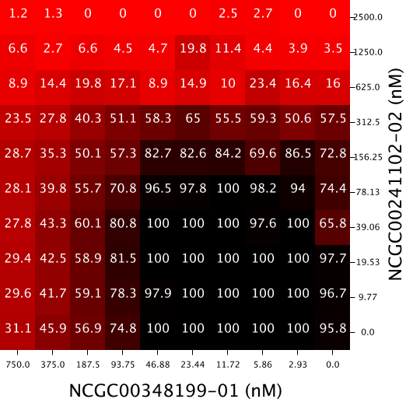
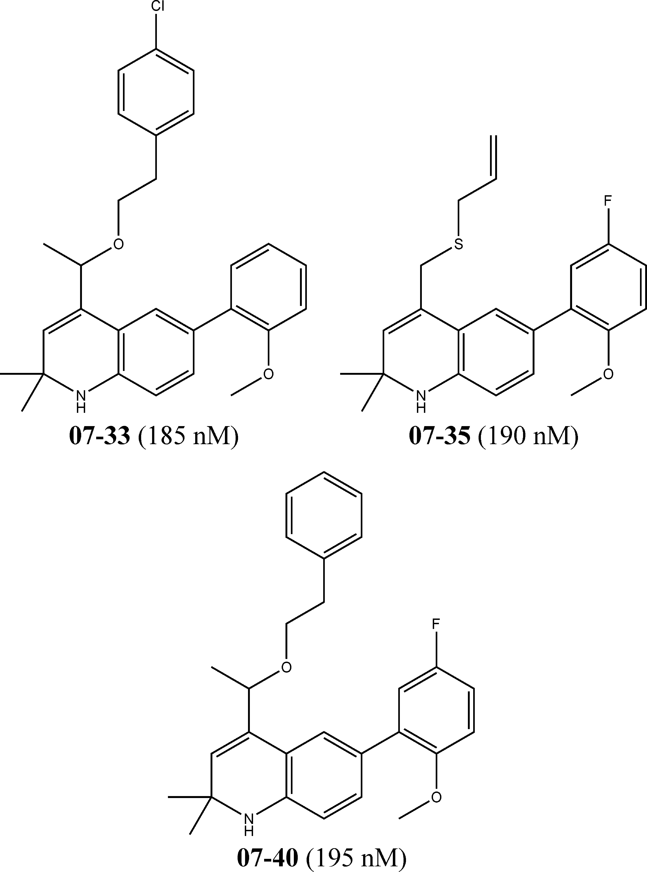
Introduction- Similarity Property Principle
Similarity Property Principle: “similar compounds have similar properties”
Similar Compounds show similar activities
Dissimilar Compounds show dissimilar activities
Would similar response matrices show similar synergy matrices?
Would similar corresponding compounds in a combination show similar synergy matrices?
(look at wiki page for reference and information)
(need the activities for the compounds and the dissimilar compounds)

Slide 6
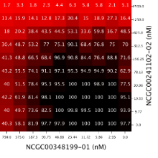
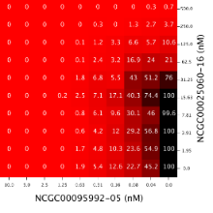

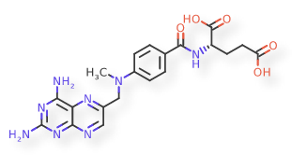
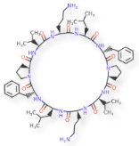
Overarching Questions
Drug Combo A:
Response Matrix
Drug Combo B:
Response Matrix
Question 1: What are metrics to quantify synergy between two responses?
Question 2: Does combination response correlate to synergy? How?
Question 3: Does chemical structure correlate to combination response? Synergy? How?
Question 4: Does dose response correlate to combination response? Synergy? How?
Drug Combo A:
Response Matrix
Drug Combo A:
Delta Bliss Matrix
Drug Combo A:
Compounds
Drug Combo B:
Compounds
Drug Combo A:
Response Matrix
Drug Combo B:
Response Matrix

Slide 7
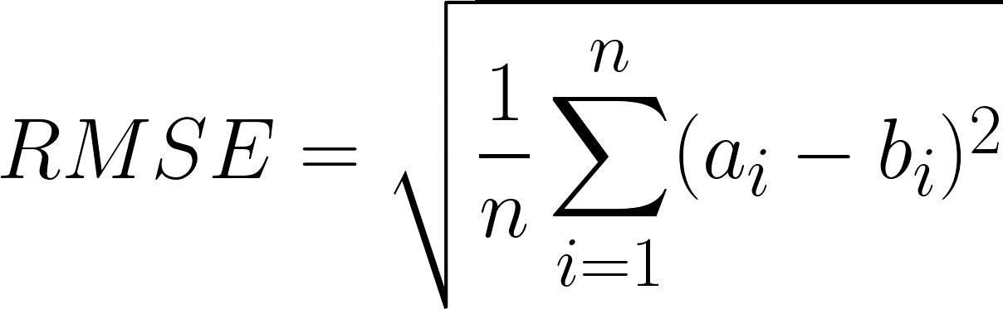
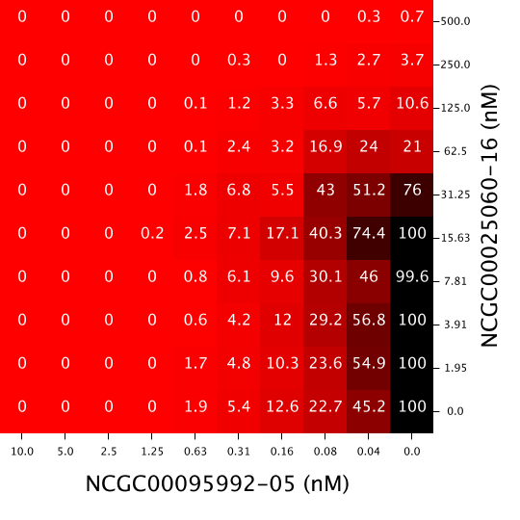
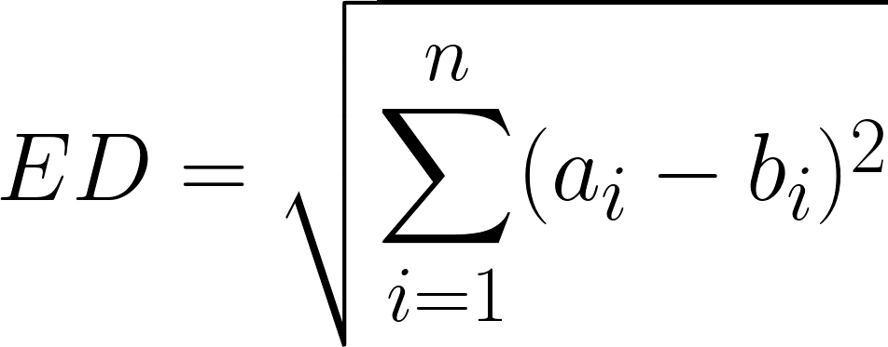
Question 1: Dissimilarity Metrics
Insensitive to Spatial Distribution
Sensitive to Spatial Distribution
1. Root Mean Standard Error (RMSE)
2. Euclidean Distance (ED)
3. Two- Sample Kolmogorov-Smirnov Test (KS Test)
4. Syrjala Test
Drug Combo A
Drug Combo B

Slide 8
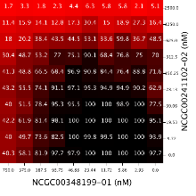
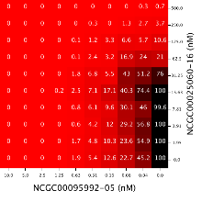
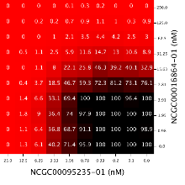
Question 1: Dissimilarity Metrics- Response Matrices in an Assay
Step 1: Compare one drug combination
to one other drug combination
Step 2: Compare one drug combination
to all other drug combinations
Step 3: Compare all drug combinations
to all other drug combinations

Slide 9
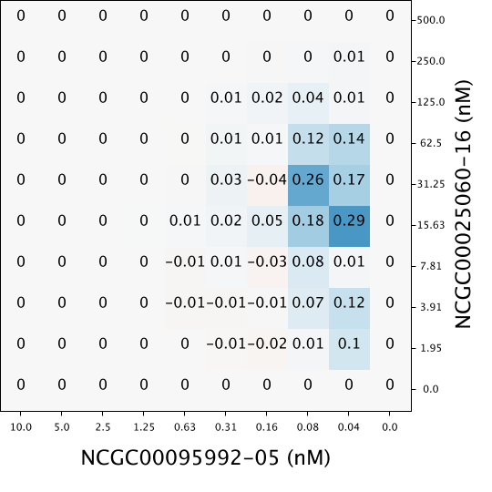


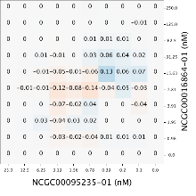
Question 1: Dissimilarity Metrics- Delta Bliss (Synergy) Matrices in an Assay
Step 1: Compare one drug combination
to one other drug combination
Step 2: Compare one drug combination
to all other drug combinations
Step 3: Compare all drug combinations
to all other drug combinations

Slide 10
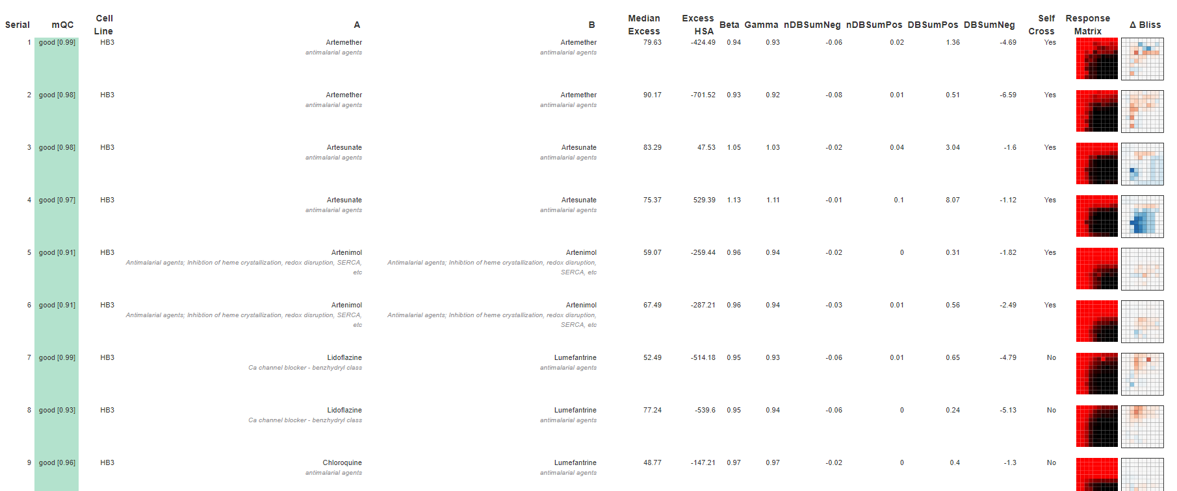
Question 1: Dissimilarity Metrics- Malaria Assay 1764 (480 Drug Combinations)
(First 9 drug combinations displayed; 480 total in the assay)

Slide 11
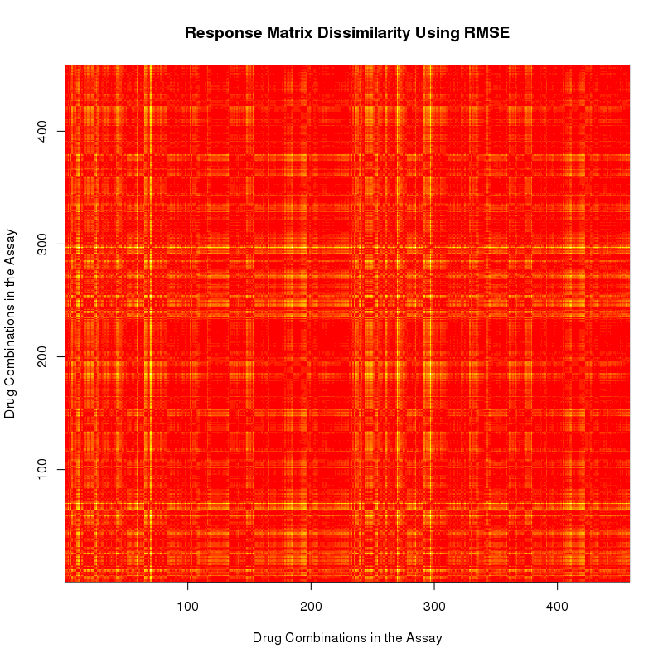
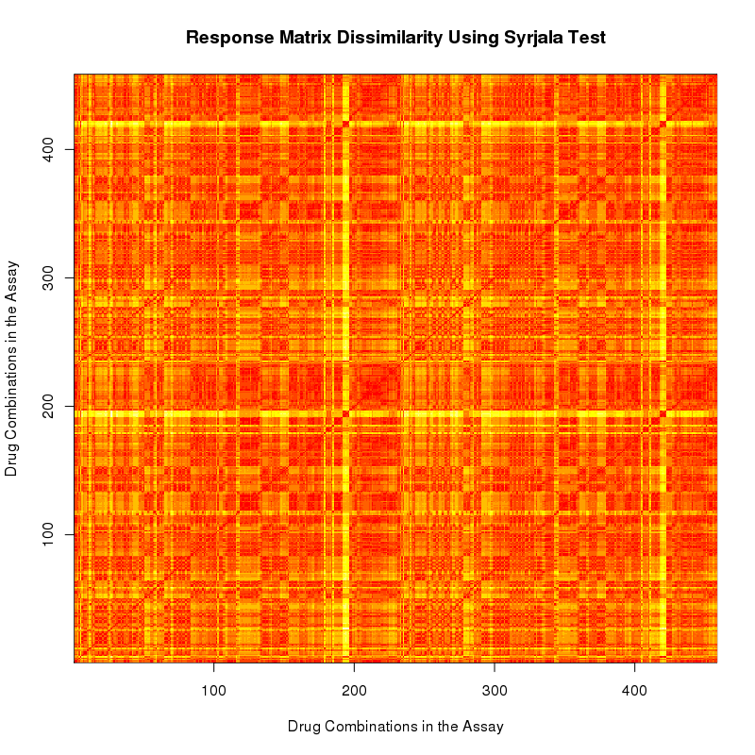
Question 1: Dissimilarity Metrics- Malaria Assay 1764 Response Matrices
RMSE
Syrjala Test

Slide 12
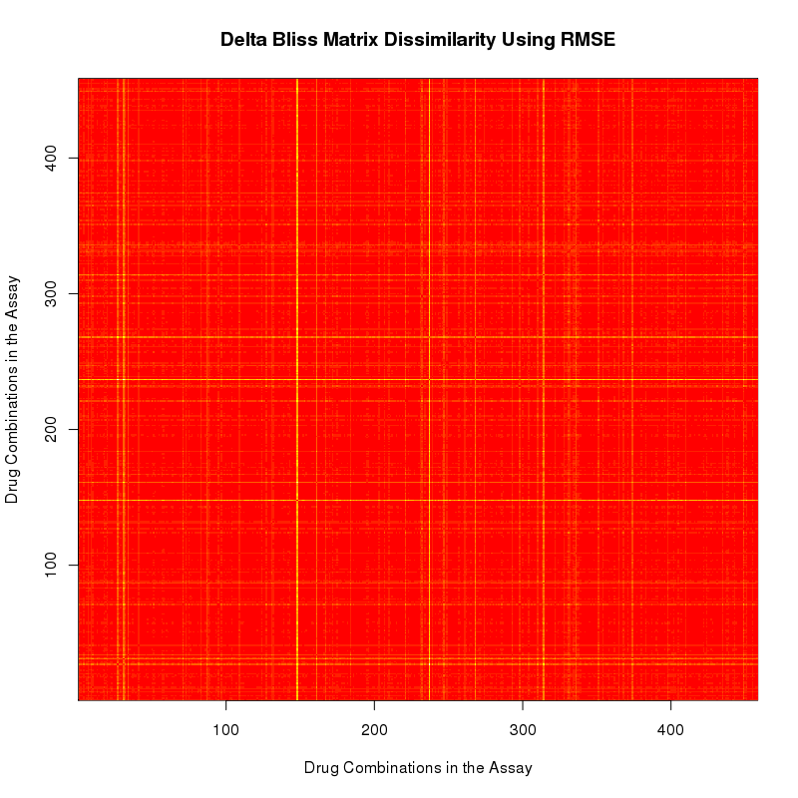
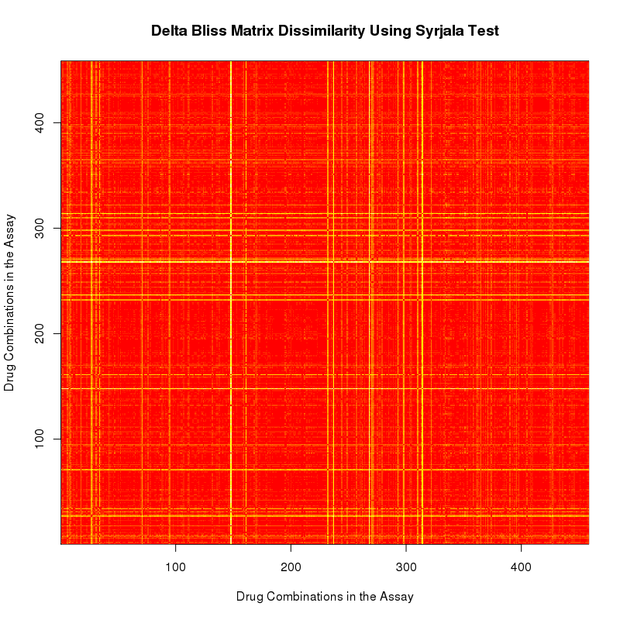
Question 1: Dissimilarity Metrics- Malaria Assay 1764 Delta Bliss Matrices
RMSE
Syrjala Test

Slide 13
Overarching Questions
Drug Combo A:
Response Matrix
Drug Combo B:
Response Matrix
Question 1: What are metrics to quantify synergy between two responses?
Question 2: Does combination response correlate to synergy? How?
Question 3: Does chemical structure correlate to combination response? Synergy? How?
Question 4: Does dose response correlate to combination response? Synergy? How?
Drug Combo A:
Response Matrix
Drug Combo A:
Delta Bliss Matrix
Drug Combo A:
Compounds
Drug Combo B:
Compounds
Drug Combo A:
Response Matrix
Drug Combo B:
Response Matrix

Slide 14


Question 2: Activity Correlated With Synergy
Is there a correlation between the dissimilarity of response surfaces and the dissimilarity of the delta bliss (synergy) surfaces ?
Drug Combo
A
Drug Combo
A
Drug Combo
B
Drug Combo
B

Slide 15
Question 2: Activity Correlated With Synergy- Malaria Assay 1764
Response Matrix Dissimilarity-
Syrjala Test
Delta Bliss (Synergy) Matrix Dissimilarity-
Syrjala Test
Do these correlate?

Slide 16
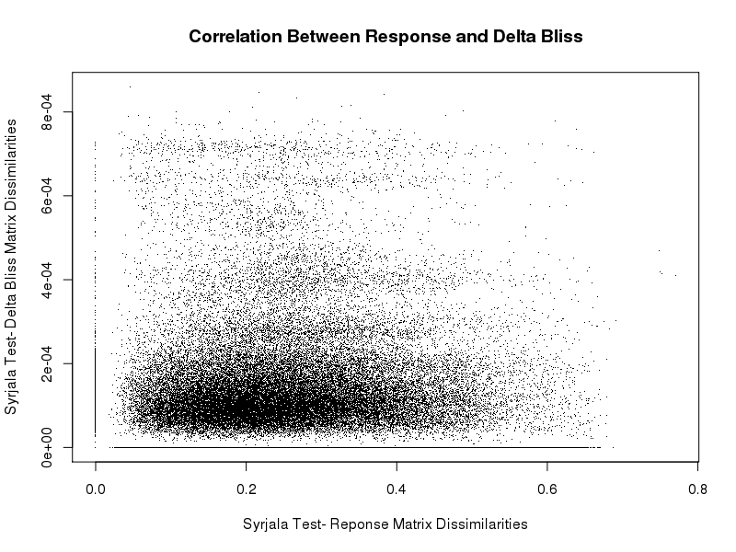
Question 2: Activity Correlated With Synergy- Response Surfaces vs Delta Bliss Surfaces

Slide 17
Overarching Questions
Drug Combo A:
Response Matrix
Drug Combo B:
Response Matrix
Question 1: What are metrics to quantify synergy between two responses?
Question 2: Does combination response correlate to synergy? How?
Question 3: Does chemical structure correlate to combination response? Synergy? How?
Question 4: Does dose response correlate to combination response? Synergy? How?
Drug Combo A:
Response Matrix
Drug Combo A:
Delta Bliss Matrix
Drug Combo A:
Compounds
Drug Combo B:
Compounds
Drug Combo A:
Response Matrix
Drug Combo B:
Response Matrix

Slide 18
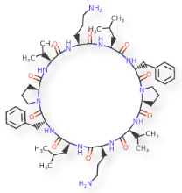
Question 2: Activity Correlated With Synergy
Is there a correlation between the dissimilarity of the compounds and the dissimilarity of the delta bliss (synergy) surfaces?

Slide 19
Question 3: Structure Correlated With Response- Dissimilarity of Compounds
Step 1. Compare one drug combination to another drug combination
Compare corresponding x agents
Compare corresponding y agents
Average those values
Step 2: Compare one drug combination to all other drug combinations
Step 3: Compare all drug combinations to all other drug combinations
x agents’ dissimilarity
y agents’ difference
Average dissimilarity

Slide 20
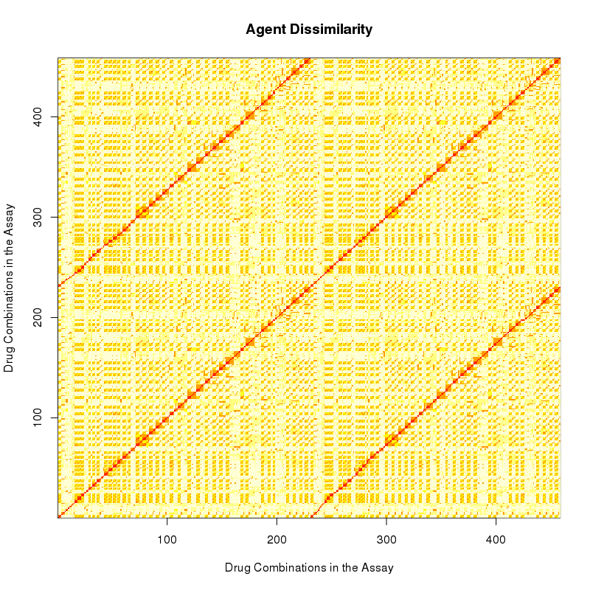
Question 3: Structure Correlated With Response- Malaria Assay 1764
Compound Dissimilarities
Response Matrix Dissimilarities-
Syrjala Test
Do these correlate?

Slide 21
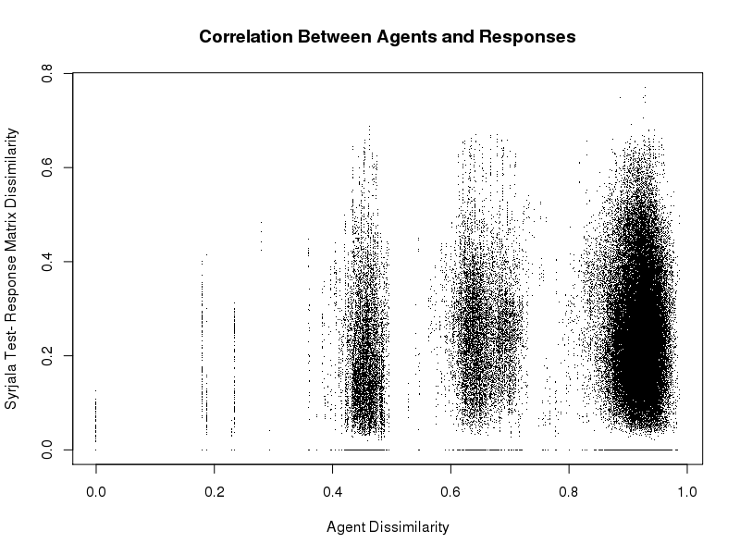
Question 3: Structure Correlated With Response- Compounds vs Response Surfaces

Slide 22
Question 3: Structure Correlated With Synergy- Malaria Assay 1764
Compound Dissimilarities
Delta Bliss (Synergy) Matrices-
Syrjala Test
Do these correlate?

Slide 23
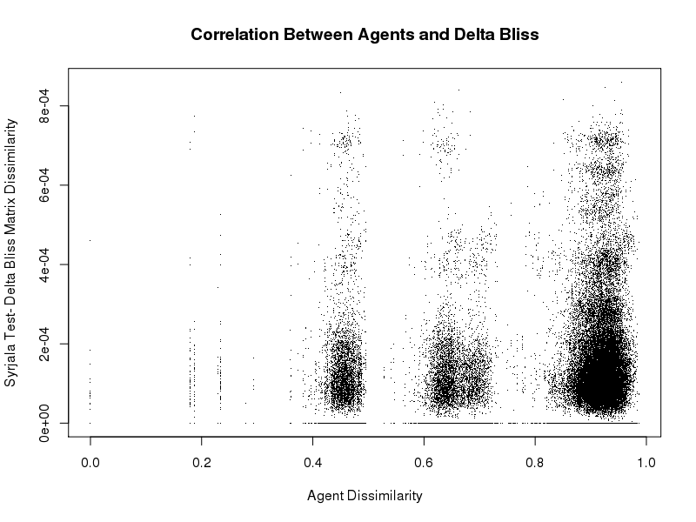
Question 3: Structure Correlated With Synergy- Dissimilarity of Compound vs Dissimilarity of Delta Bliss Surfaces

Slide 24
Overarching Questions
Drug Combo A:
Response Matrix
Drug Combo B:
Response Matrix
Question 1: What are metrics to quantify synergy between two responses?
Question 2: Does combination response correlate to synergy? How?
Question 3: Does chemical structure correlate to combination response? Synergy? How?
Question 4: Does dose response correlate to combination response? Synergy? How?
Drug Combo A:
Response Matrix
Drug Combo A:
Delta Bliss Matrix
Drug Combo A:
Compounds
Drug Combo B:
Compounds
Drug Combo A:
Response Matrix
Drug Combo B:
Response Matrix

Slide 25
Question 4: Dose Response Correlated With Response- Dissimilarity of Dose Responses
Step 1. Compare one dose response to another dose response
Compare corresponding x agents
Compare corresponding y agents
Average those values
Step 2: Compare one dose response to all other dose responses
Step 3: Compare all dose responses to all other dose responses
x dose responses’ dissimilarity
y dose responses’ difference
Average dissimilarity

Slide 26
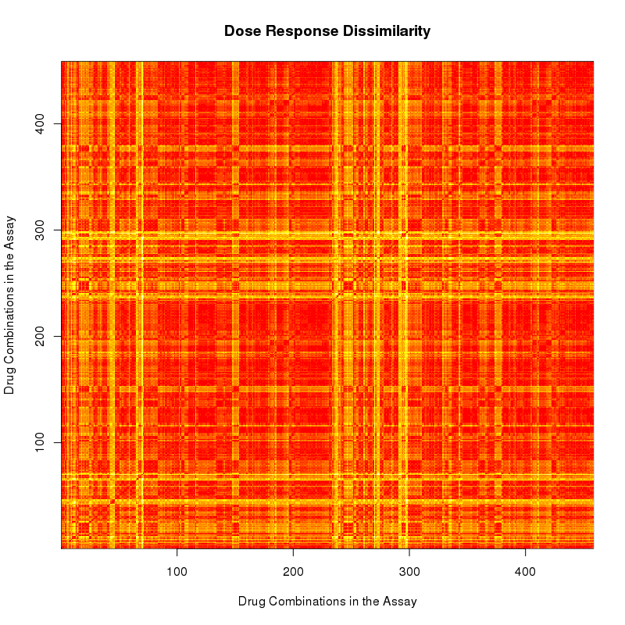
Question 4: Dose Response Correlated With Response- Malaria Assay 1764
Dose Response Dissimilarities
Response Matrices-
Syrjala Test
Do these correlate?

Slide 27
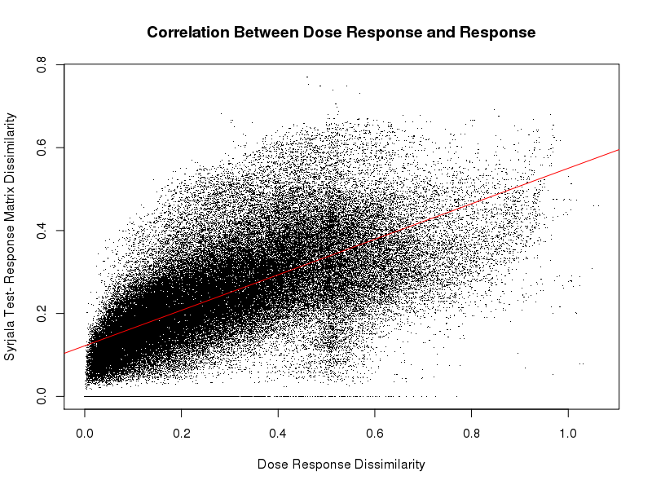
Question 4: Activity Correlated With Synergy- Dissimilarity of Dose Response vs Dissimilarity of Response

Slide 28
Question 4: Dose Response Correlated With Synergy- Malaria Assay 1764
Dose Response Dissimilarities
Delta Bliss (Synergy) Matrices-
Syrjala Test
Do these correlate?

Slide 29
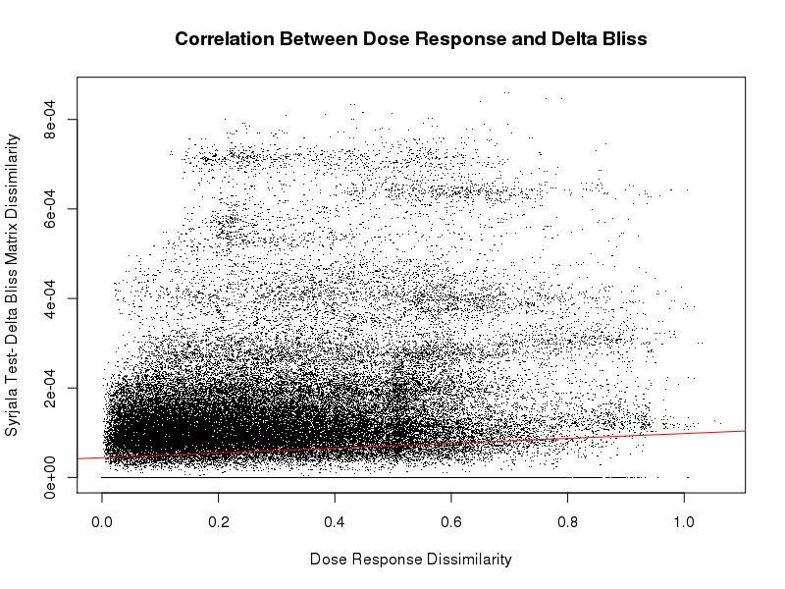
Question 4: Activity Correlated With Synergy- Dose Response vs Delta Bliss

Slide 30
[Discussion etc.]

